Slide 1


Simplify your Code
with Helmfile
BRADEN WRIGHT | ROOT LEVEL TECHNOLOGY

Slide 2


Braden
Wright
Staff Cloud Architect
braden.wright@rootleveltech.com

Slide 3
Agenda
What’s not covered?
Kubernetes 101
Helm 101
Codefresh 101
https://github.com/rootleveltech/codefresh-helmfile-webinar

Slide 4
Agenda
Why Helmfile
What is Helmfile
Helm Repos
More Hooks
Helm Diff
Another Approach to Secrets
Helm Dependencies
Multiple Environments
Templating Values yaml
Common Problems Helmfile can help with...
https://github.com/rootleveltech/codefresh-helmfile-webinar

Slide 5
Why Helmfile?
I love Helm but if only I could ...
Setup Helm Repos
Automate something to run before / after Helm
See what’s going to change before Deploying
Manage Secrets as part of Helm Deploy
Have dependencies installed as separate Helm Deploy
Control order of my Helm chart dependencies
Template values.yaml
Get data from another source / run a script
Use Environment Variables
Notes:
Env vars -> required and default values, maybe terraform, set env var which can then be leverage by helmfile

Slide 6
What is Helmfile?
Wrapper on top of Helm
No Vendor Lock-in
Golang Templating without Restrictions
https://github.com/roboll/helmfile
Notes:
No lock in. Built on top of helm, you can bail and just start using native helm, or helmfile will see releases installed via vanilla Helm.
Get picture of a yaml file that’s not DRY, maybe traefik or dns chart

Slide 7
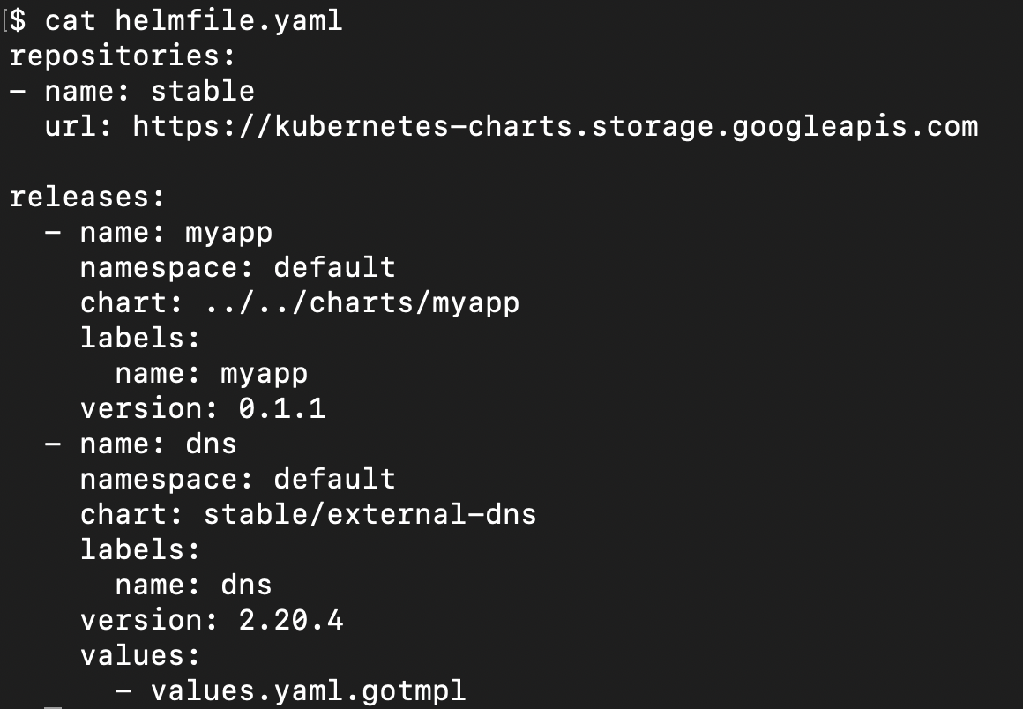
What is Helmfile?
Notes:
Define things like:
Repositories
Releases (local charts or charts from public repo)
Templated values.yaml
Much more

Slide 8
Demo Disclaimer
Walkthrough deploys
Starting from a completely clean GKE install
Setup in GCP for things like DNS, credentials, etc.
Mono Repo for our example

Slide 9
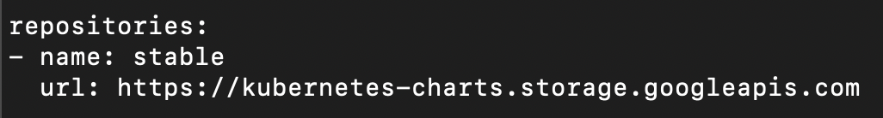
Helm missing Repos
Notes:
No code yet

Slide 10
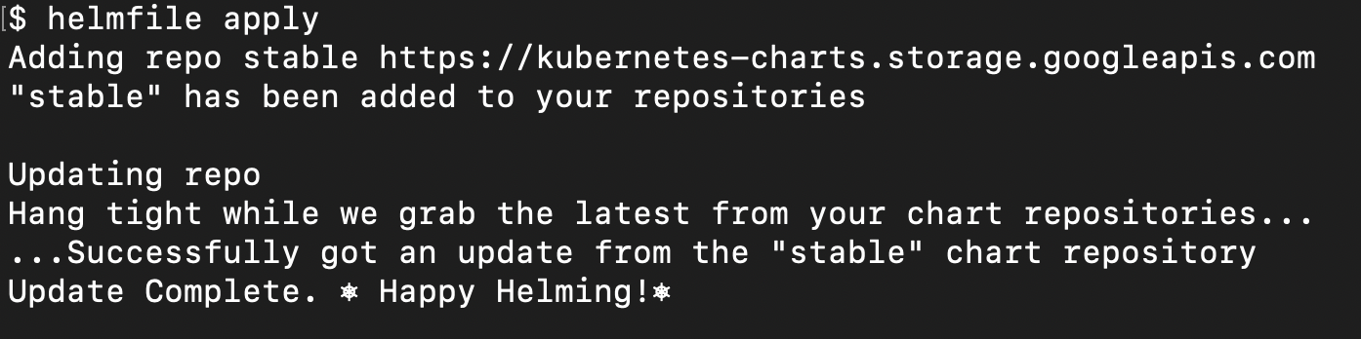
Helm missing Repos
Notes:
Change out helmfile diff for helmfile apply

Slide 11
Helmfile Hooks
Events: prepare, presync, postsync, cleanup
Notes:
code-01
Example of using hooks, like creating a namespace, creating hostname via xip.io and ingress ip address, run terraform, get variables / files from a location, run lint

Slide 12
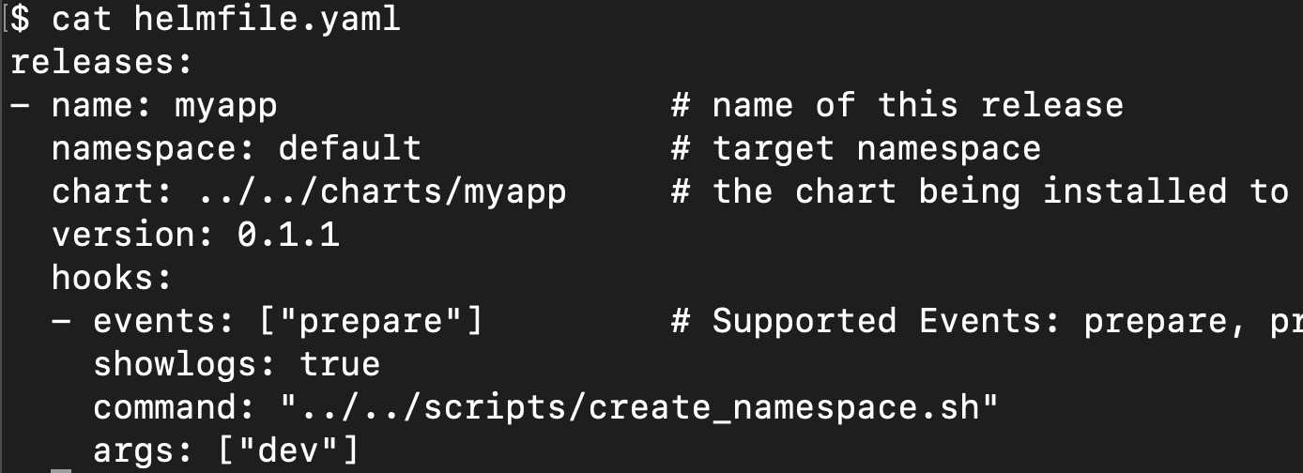
Helmfile Hooks
Example: create Namespace before deploying chart
Notes:
code-04
Example of using hooks, like creating a namespace, creating hostname via xip.io and ingress ip address, run terraform, get variables / files from a location, run lint

Slide 13
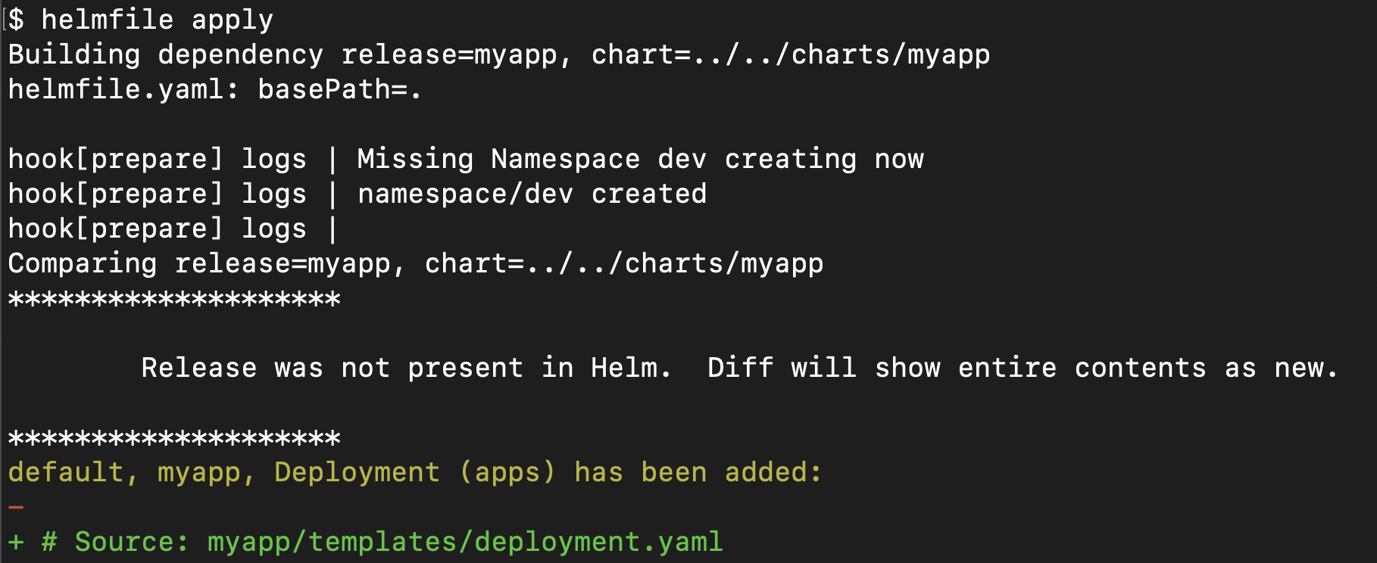
Helmfile Hooks
Example: create Namespace before deploying chart
Notes:
code-04
Example of using hooks, like creating a namespace, creating hostname via xip.io and ingress ip address, run terraform, get variables / files from a location, run lint

Slide 14
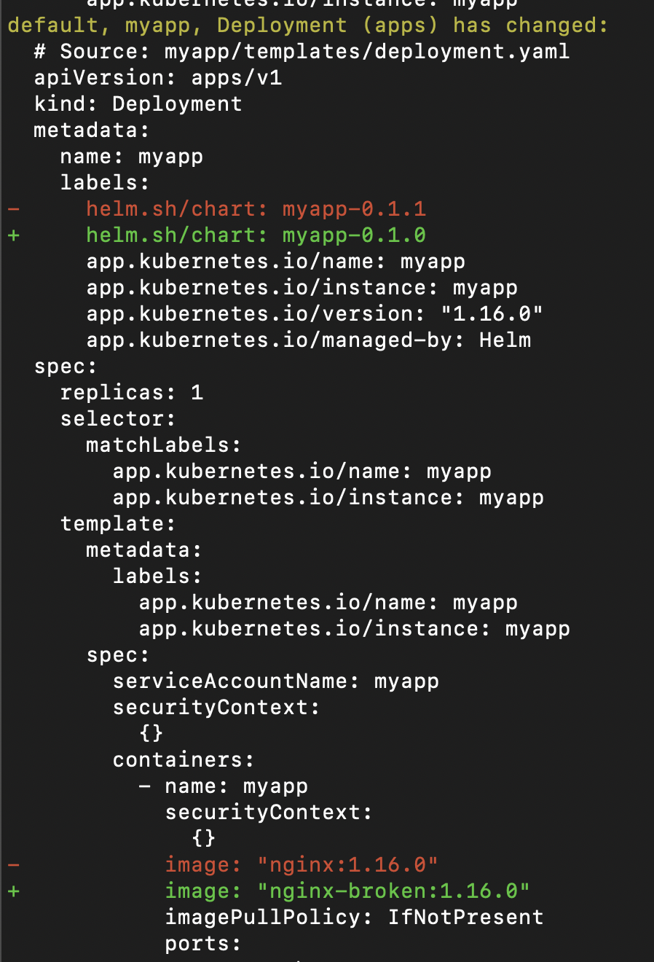
Helm Diff
Want Terraform Plan for Helm?
Bug for Helm 3, 3-way diff
Notes:
No code

Slide 15
Helm Secrets
How do you create secrets?
Where do you store sensitive data?
How do you distribute / share sensitive data?
https://github.com/zendesk/helm-secrets
Notes:
How do you create secrets? (cli, helm secret resource, terraform, ci/cd pipeline using secret variables)
Where do you store sensitive data? (sensitive variable, lastpass)
How do you distribute / share sensitive data? (run from different places need to setup secrets)
https://gist.github.com/twolfson/01d515258eef8bdbda4f#setting-up-sops-with-pgp
Helm secrets plugin
Pic of Secrets in CF

Slide 16
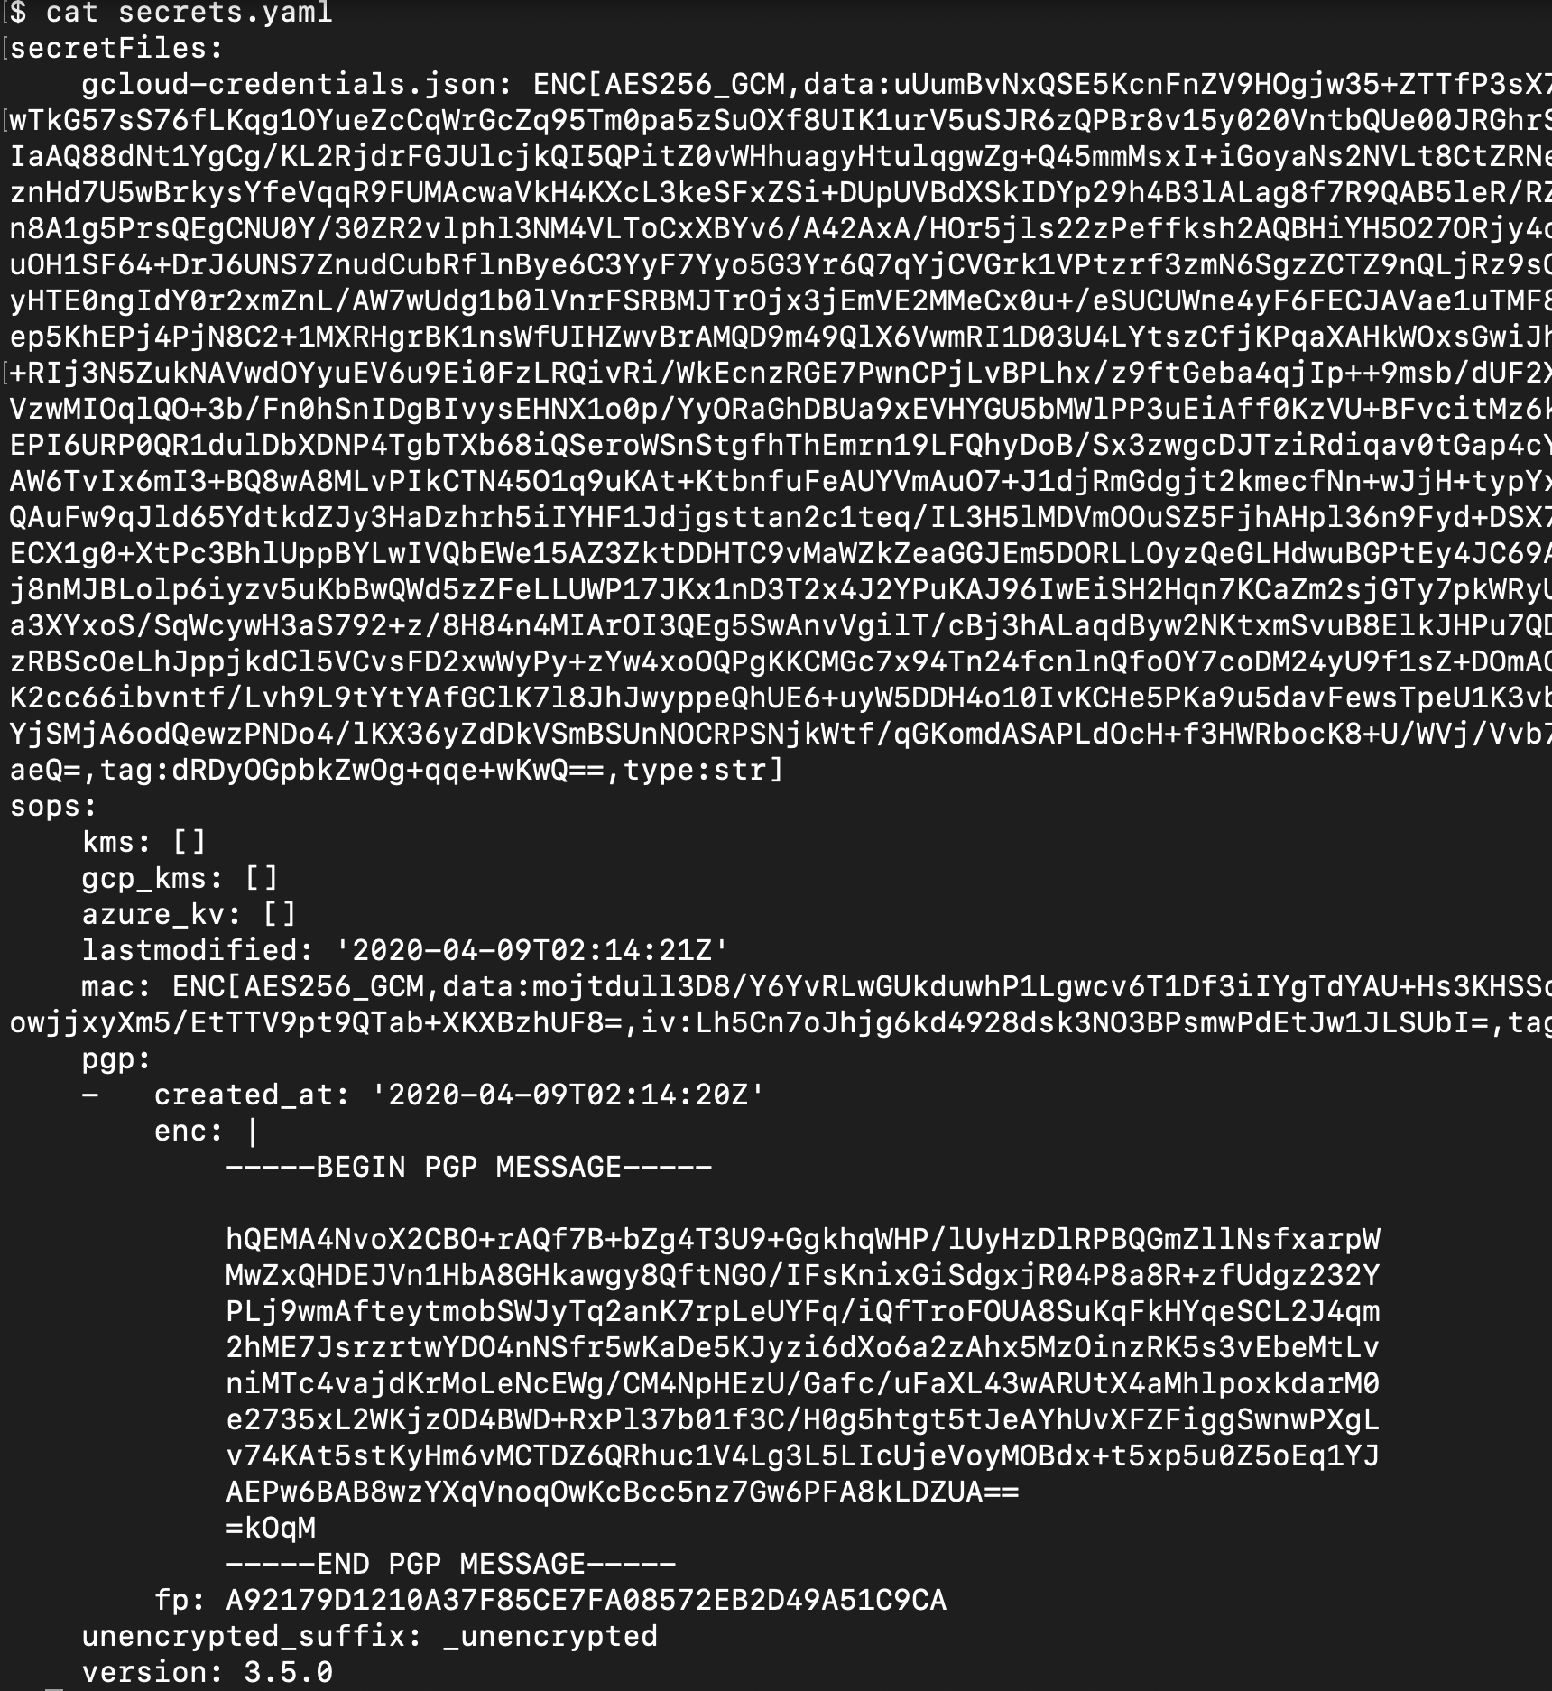
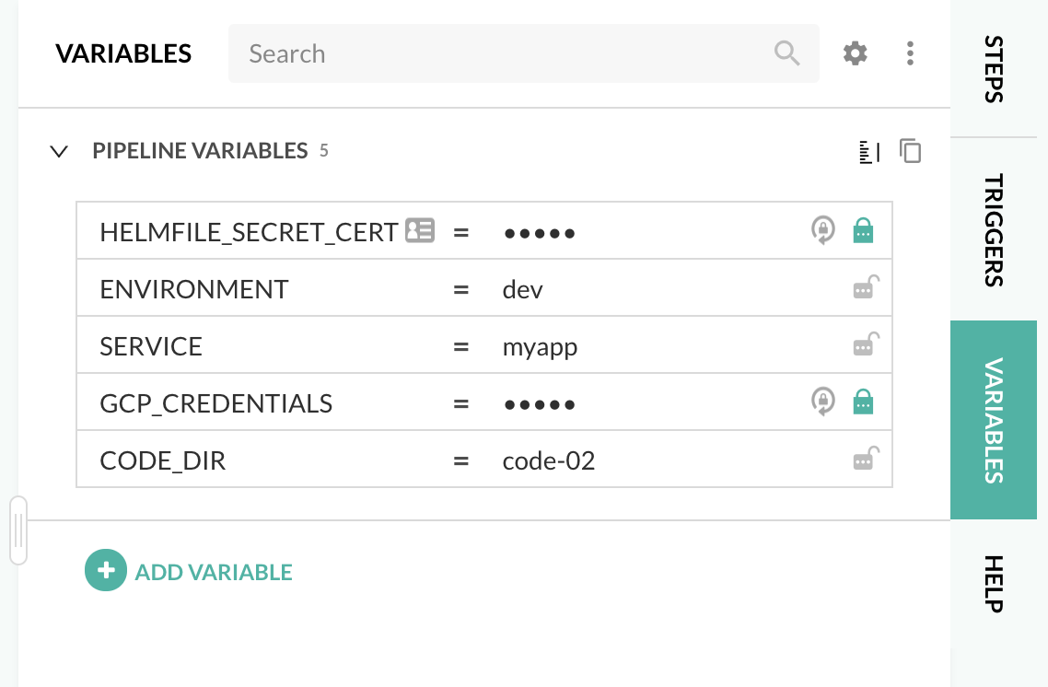
Helm Secrets
Notes:
In the former case, containers do not start. In the latter instance, the application code fails after the container starts up. We’ll address each of these situations systematically.
The kubectl command-line utility will be used to interact with K8S throughout this exercise.

Slide 17
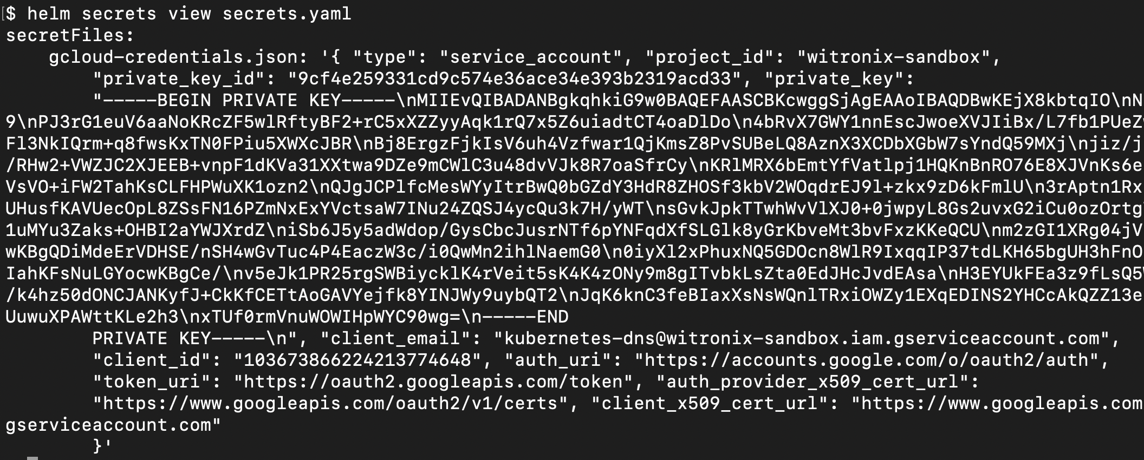
Helm Secrets
Notes:
In the former case, containers do not start. In the latter instance, the application code fails after the container starts up. We’ll address each of these situations systematically.
The kubectl command-line utility will be used to interact with K8S throughout this exercise.

Slide 18
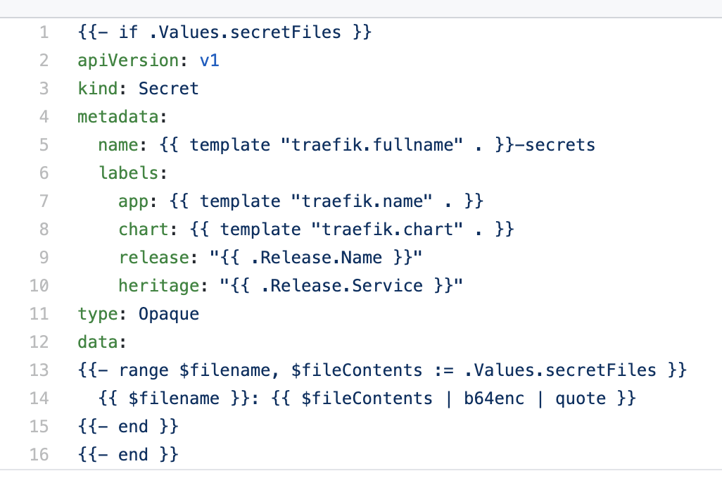
Helm Secrets
Notes:
In the former case, containers do not start. In the latter instance, the application code fails after the container starts up. We’ll address each of these situations systematically.
The kubectl command-line utility will be used to interact with K8S throughout this exercise.

Slide 19
Helm Secrets
Helmfile uses Helm Secrets Plugin which uses SOPS
SOPS supports different types of Encryption
AWS KMS, GCP KMS, Azure Key Vault, PGP, etc
Secrets.yaml file gets encrypted and saved in Git
Use a Secret Resource and unencrypted Secrets.yaml to create safe, secure, reliable, repeatable and distributed way to create Resources
https://github.com/zendesk/helm-secrets
https://github.com/mozilla/sops
https://gist.github.com/twolfson/01d515258eef8bdbda4f
Notes:
https://medium.com/@mel000vin_14011/encrypting-helm-secrets-7f37a0ccabeb

Slide 20
Order Dependencies
Runs Helm apply times
Run Helm deploy in specified order
Deploy parts of Stack using labels and selectors
Different ways to declare dependencies
Notes:
In the former case, containers do not start. In the latter instance, the application code fails after the container starts up. We’ll address each of these situations systematically.
The kubectl command-line utility will be used to interact with K8S throughout this exercise.

Slide 21


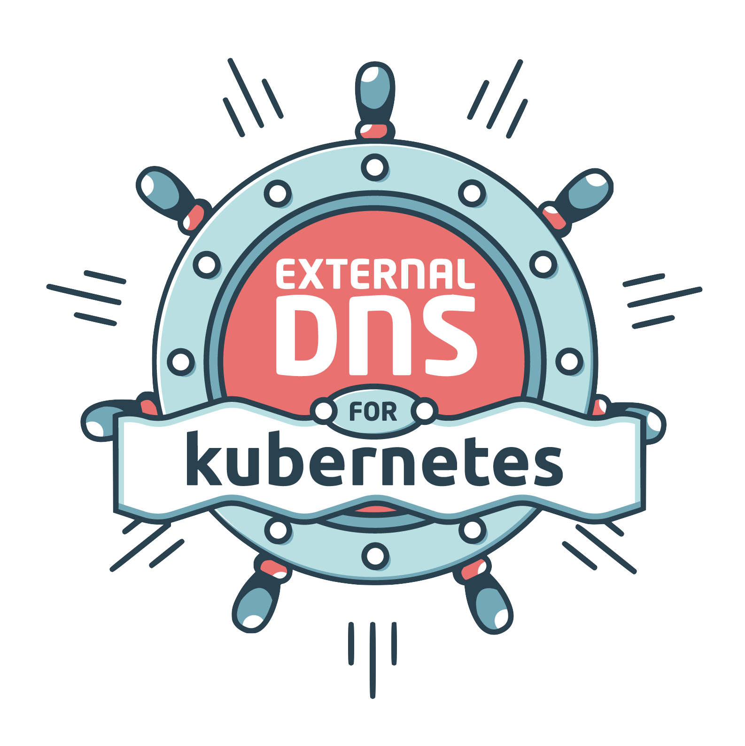
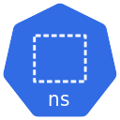
Order Dependencies
4
3
2
1
Notes:
Quickly Talk about:
Nginx / MyApp
Traefik / Ingress
External DNS
Namespace

Slide 22
Demo in Codefresh
Deploy MyApp, Ingress, DNS, Namespace
Using Secrets.yaml
Started with cfstep-helmfile but needed to customize
https://codefresh.io/steps/step/helmfile
Notes:
https://g.codefresh.io/build/5ea167807f303104ba5dec59
Not failing b/c of missing dependencies or secrets or namespace
Deploy via Codefresh (dev env)
Talk about Changes need to Helmfile image, and how I use a freestyle step
Only added to cfstep-helmfile: (1) gnupg for GPG
(2) gcloud for kubectl command used in script
Saved cfstep-helmfile in my repo

Slide 23
Templating Values Yaml Files
DRYing out values files
Use Templating to support ad-hoc environments
Hierarchy, environment level values files, with default but ability to override.
Use Env Vars in values.yaml file
Run scripts to return values
Expose all of Sprig / Go Templating
Render out other files
Use different Secrets.yaml for Different Environments
Notes:
In the former case, containers do not start. In the latter instance, the application code fails after the container starts up. We’ll address each of these situations systematically.
The kubectl command-line utility will be used to interact with K8S throughout this exercise.

Slide 24
Demo in Codefresh
Deploy Stack in 2 Environments
Dev
DNS in GCP / CloudDNS
External DNS Chart
Default / Ad-Hoc
Leverage Templating / Script to setup an .xip.io address
Notes:
## Codefresh Code-03, first run
https://g.codefresh.io/build/5ea14da5aeb43723807d6323
## Codefresh Code-03, second run
https://g.codefresh.io/build/5ea14f6dfa96150711a0519b
Deploy via Codefresh (dev env)
Code-07
Mention XIP.IO (don’t need to deploy DNS chart)

Slide 25
Environments
Picture of Yaml with Multiple Environments
Setup another environment, on the same K8s cluster
Setup another environment in a different K8s cluster
Leverage Templating for Ad-Hoc environments

Slide 26
Other Helmfile Features
Repo Per Chart
Modules
GitHub, S3, etc.
Env Variables
Supports standard, default, required
Top Level Helmfile to Deploy everything
Use Helmfile with Kustomize
Notes:
In the former case, containers do not start. In the latter instance, the application code fails after the container starts up. We’ll address each of these situations systematically.
The kubectl command-line utility will be used to interact with K8S throughout this exercise.

Slide 27
Mono Repo vs Repo per Chart
Talk about mono repo approach we’ve been taking, common b/c of public helms charts repo. Helmfile flexible, so you can setup how you want to
Discuss Repo per Chart and things like getting Helmfile from git instead of a local file.
Notes:
In the former case, containers do not start. In the latter instance, the application code fails after the container starts up. We’ll address each of these situations systematically.
The kubectl command-line utility will be used to interact with K8S throughout this exercise.

Slide 28
Other Tools
Look at Helm Plugins
Secrets, Diff
Helmsman, Kustomize
Check Ecosystem, lots of tools
Other Tools / Charts
https://github.com/stakater/Reloader
https://github.com/kubernetes-sigs/external-dns
https://github.com/jetstack/cert-manager
https://github.com/vmware-tanzu/velero
Notes:
In the former case, containers do not start. In the latter instance, the application code fails after the container starts up. We’ll address each of these situations systematically.
The kubectl command-line utility will be used to interact with K8S throughout this exercise.

Slide 29
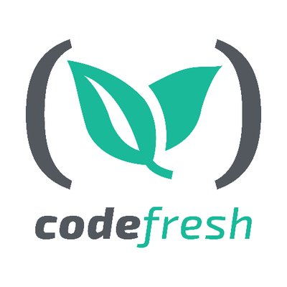

Summary
Simple Case Study
Consider SDLC for Charts
Tons of power with Sprig / Go Templating
Try out Helmfile, or evaluate what’s out there
Notes:
Is it really simplier? Yes and No. Adding complexity to keep things simple
Simple Case Study, deploying 1 chart has issues everyone is gonna come across
SDLC -> consider how to develop and run from diff places not just running in CICD
GoLang Templating is super powerful, reason I went with Helmfile over Helmsmen

Slide 30

Questions?
Signup for a FREE account with UNLIMITED builds
& schedule a 1:1 with
our experts at
https://codefresh.io
Schedule a no cost, 1:1 call with our cloud migration specialists at
https://rootleveltech.com/

